Slide 2
React & Accessibility
Jeffrey Johnson
Notes:
Say Hello
Thank Everyone for Attending
Tell everyone how passionate you are about accessibility

Slide 3
Agenda
A11y in a nutshell (5m)
ARIA Implementation and Examples (10m)
React and Accessibility (10m)
Tools for Accessibility (Both React and Not) (5m)
Notes:
• What is accessibility?
• Who does accessibility Impact?
• Why do we focus on Accessibility?
• How do we design for Accessibility?
• How do we develop for Accessibility?

Slide 4
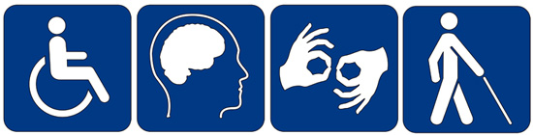
A11y in a nutshell

Slide 5
What is Accessibility
“A measure of a computer system's accessibility to all people, including those with disabilities or impairments”
Summary: Make the web accessible to all users regardless of disabilities
A11y
Numronym: a word where a number is used to form an abbreviation
Notes:
Overall, defined as a measure of a computer systems accessibility is to all people including those with disabilities or impairment
Overall, its designing, developing, and providing a way for all users to have equal access

Slide 6
Why Develop for Accessibility?
Everyone is included in accessibility
~ 9.9 Percent of the noninstitutionalized population has a disability
Guesstimate that potentially 1.1 million Concur users face a disability either known/unknown.
* US Census Data Contains more information regarding these numbers
* According to Google Analytics – 14 million active users utilized Concur in 2016
Notes:
Everybody
According to the US Cencus Beuro, 9.9% of non institutionalized individuals report having an impairment

Slide 7
Types of Impairments
Visual
Motor
Auditory
Cognitive
Notes:
Its important to recognize that disabilities are greater than just visual impairment
There are for categories when we talk about accessibility and accessibility development.
Some people might be in one single category, or have a few impairments from a few categories

Slide 8
Visual
Description
Technologies Utilized
This can be non-sighted users, users with low-vision, users with obstructed vision, or even simply your aging parents.
Technologies/Techniques Used
Screen Reader
JAWS
NVDA
Window Eyes
VoiceOver
ChromeVox
Screen Magnifier
Notes:
Most commonly talked about among developers
Includes a range of vision impairment, not just full vision loss
Two types of tech
Screen readers
Screen Maginifiers

Slide 9
Auditory
Description
Technologies / Techniques
The web is a visual medium, but captions and fallbacks for sound-necessary media need to be considered for hearing impaired users.
Closed Captioning
Alternative for Auditory Alerts
Notes:
Less in our area of concern but still very important to consider when designing interfaces

Slide 10
Motor
Description
Technologies / Techniques
People with motor impairments typically use a wide range of assistive technology from specialized keyboards, to eye trackers, to using single buttons to navigate their computer.
Keyboard Navigation
Switch Navigation
Sip/Puff Navigation
Notes:
Keyboard navigation is critical for these cases

Slide 11
Cognitive
Description
Technologies / Techniques
Relates to the ease processing of information.
Drives development of simple workflows and less compel UI
N/A
Ease of use occurs in the design phase
Notes:
Creating customizable content and workflows is one way to help reduce cognitive load
Disabling functionality of a browser
Things we do not focus on from a development side as we include everyone versus exclude features

Slide 12

How we Develop ^{’and Test’} for Accessibility?

Slide 13
Web Standards for Accessibility
Section 508
Section within the Rehabilitation Act
Rehabilitation Act is an amendment of the ADA
Establishes requirements for electronic and information technology developed, maintained, procured, or used by employers
WCAG (Web Content Accessibility Guidelines)
Published by WAI (Web Accessibility Initiative) of the W3C
Set of guidelines to make content accessible
Current version is 2.0 (Published December 2008)
Notes:
Two reasons
Legal requirements are key
They drive us to standardize access and encourage us to improve
So what is 508?
Establishes the requirements for electronic information display at work
Bubbles up to the ADA
Then what is WCAG?
Web Content Accessibility Guidelines

Slide 14
Content versus Context
Important to understand the difference between the two
Context describes a page and adds meaning based on hierarchy
Content is the visual rendering of content
Notes:
Important ot understand
Content is what you see
Context is what meaning you add into a page
We do this with HTML

Slide 15
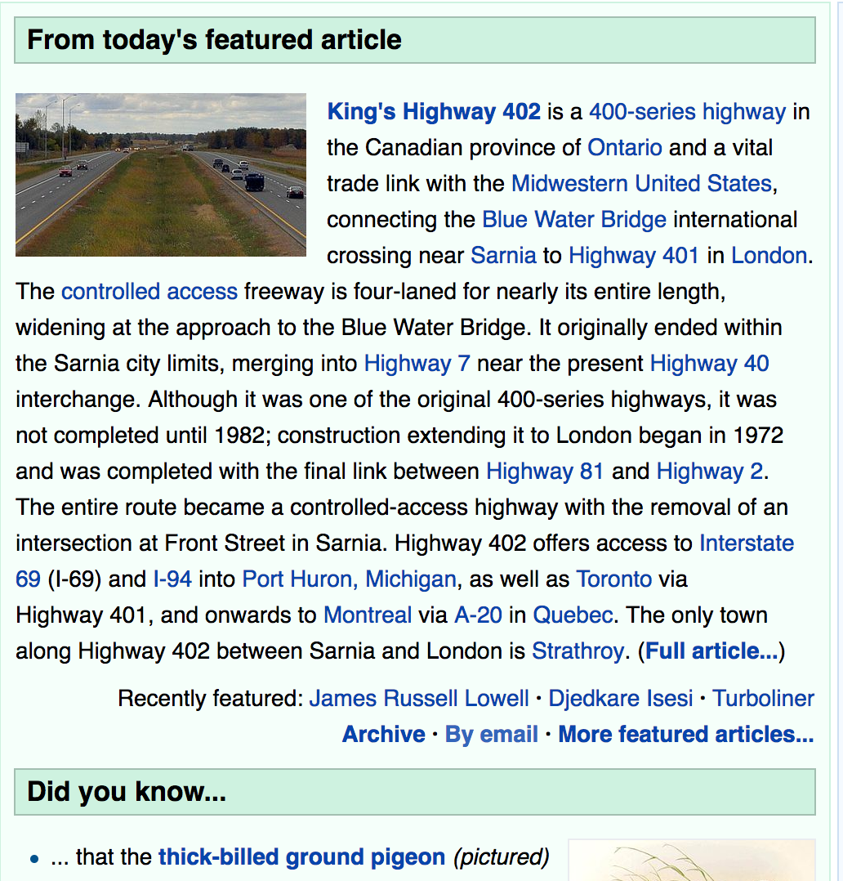
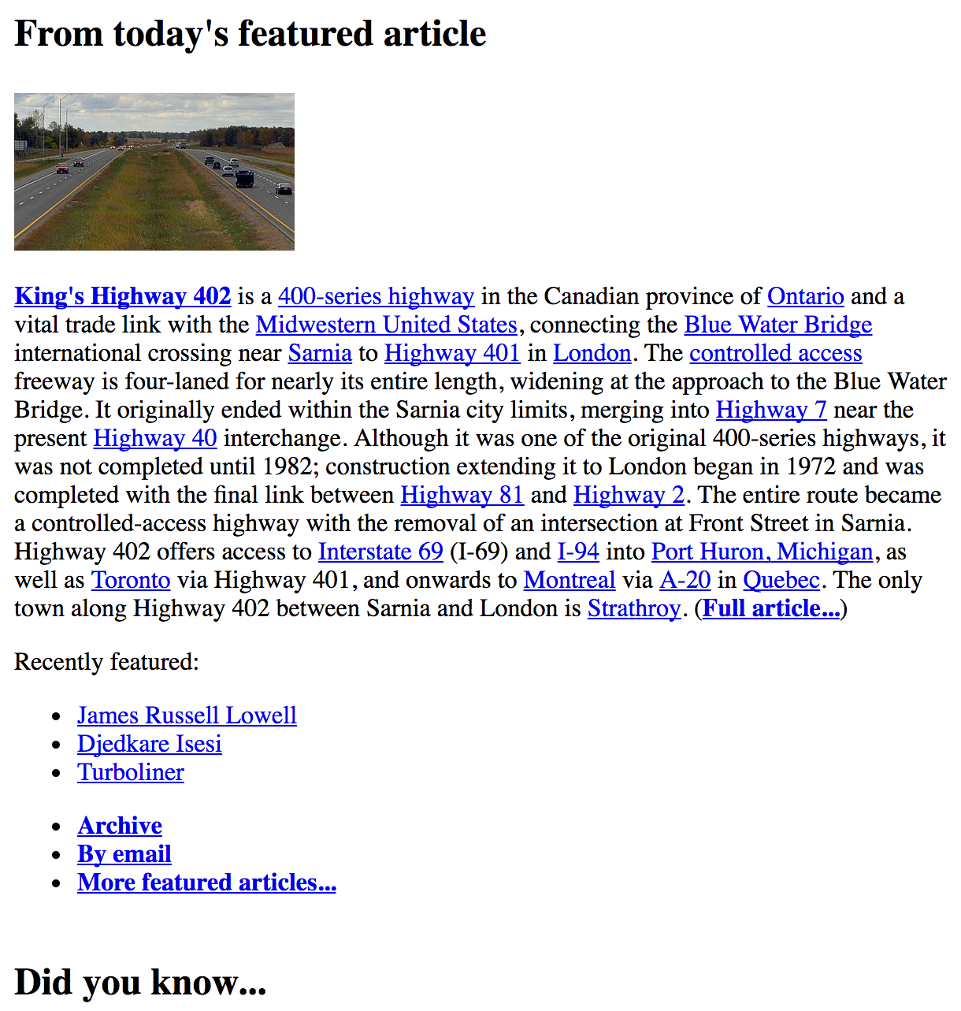
Content Compared with Context
Notes:
Take Wikipedia for example
Left is original content, styled, and made pretty
When you take the style off, the HTML conveys its context. You can see recently featured is a list, there is a list to control the article.
On the left its stylized and you’re not told it’s a list
On the right it is stylized and A11y users hear that it is a list

Slide 16
Semantic Meaning
Section describes the content
Heading helps explain content in the heading
Paragraph allows us to understand where consumable text is present
<section>
<h2>All About Kittens</h2>
<p>This paragraph will tell you all about kittens</p>
</section>
Notes:
Take this example of a section
A heading describes that this paragraph is ‘all about kittens’
The paragraph talks about the kitchens described in the header
There are many other semantic HTML elements that add this context
Images
Forms
List
Buttons
Navigation
… it’s a large list

Slide 17
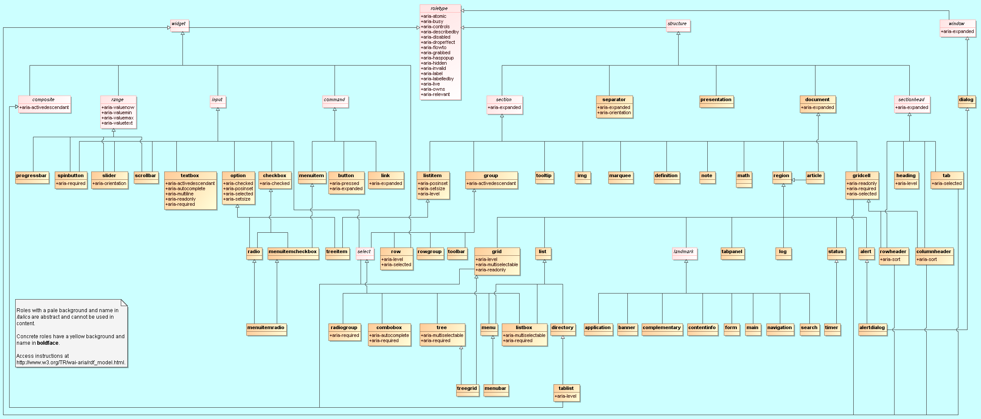
ARIA Markup (Assistive Rich Internet Applications)
Created by the W3C
Does not add browser functionality
Is an extra layer of description
Describes state of role of an element on the page
ARIA
Notes:
Does not add browser functionality
Describes state/role of a component on a page
Example:
Show that a hide show section is collapses or visible.
It also can help wire up and relate content better

Slide 18
ARIA Example - Section
ARIA allows us to add more context to existing content
ARIA relates parts of content to create better descriptions
<section aria-labelledby="KittensHeader">
<h2 id="KittensHeader">All About Kittens</h2>
<p>This paragraph will tell you all about kittens</p>
</section>

Slide 19
ARIA Example – Spinner Infinite
ARIA allows us to add more context to existing content
ARIA relates parts of content to create better descriptions
Use shortid library when ID might not be provided
<div aria-describedby="mySpinner-message" aria-live="polite" id="mySpinner" role="status">
<div class="cnqr-spinner-box">
<div class="cnqr-spinner-animaton"></div>
<div class="cnqr-spinner-message-box">
<p class="h3" id="mySpinner-message">Loading...</p>
</div>
</div>
</div>

Slide 20
ARIA Example – Spinner Definite
ARIA allows us to expose most states
<div aria-describedby="mySpinner-message" aria-live="polite" id="mySpinner" role="status” aria-valuemin='0' aria-valuemax='100' aria-valuenow='33'>
<div class="cnqr-spinner-box">
<div class="cnqr-spinner-animaton"></div>
<div class="cnqr-spinner-message-box">
<p class="h3" id="mySpinner-message">Loading (33%)</p>
</div>
</div>
</div>

Slide 21
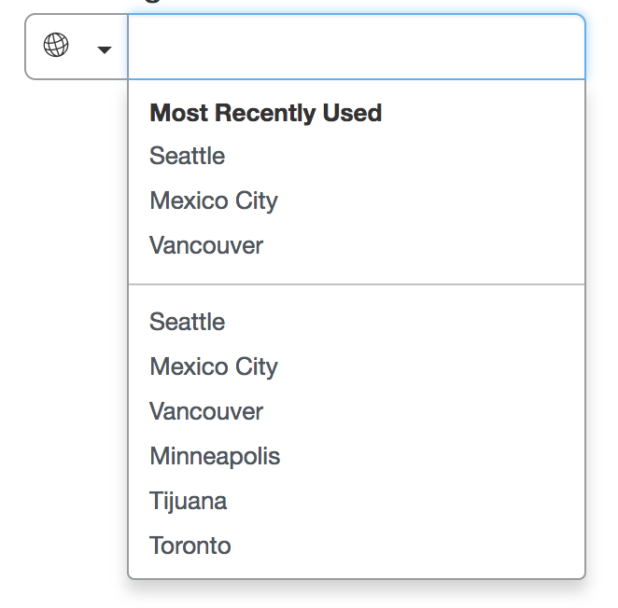
ARIA Example - Autocomplete
Role: ’Input’
Aria-HasPopup: ‘true’
Aria-AutoComplete: ‘List
Role: ’button’
Aria-label: ‘Select Country’
Role: ’Heading’
Role: ‘Menu’
Role: ‘MenuItem’
Aria-Label: ‘Seattle
Text

Slide 22
Events and Accessibility
User interactions should all be tested
Important to consider all potential interaction cases
Keyboard, Mouse, Screen Reader etc.
Important to Consider how events affect focus
React-A11y can provide excellent tracking of requirements
Helps determine if event handlers are missing
Helps determine if ARIA components should be added

Slide 23
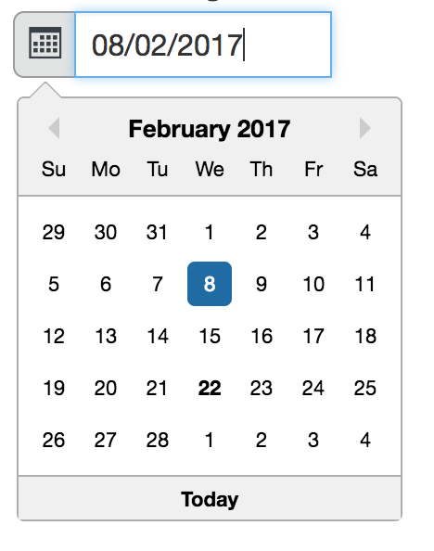
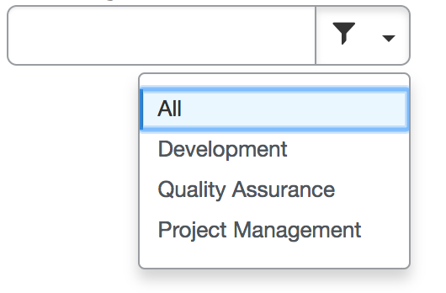
NUI-Widgets – Accessible Components
Atomized Design Process
Reusability allows us to solve accessibility issues once
Testing Unknowns / Questions Early in the Development Process
Provide Implementation Guidance on User Interaction via our Human Interface Guidelines (Hig.Concur.Com)
Notes:
My team / CORE Ui focuses on creating reusable and accessible components
We tackle testing challenges early, and provide appropriate accessibility integration
By creating reusable components, we solve many accessibility issues only once
Developing Interface and Implementation Guideline

Slide 24
Accessibility Tools

Slide 25
How to validate Accessibility
Accessibility QA Tools (AxE)
Unit Tests – Targeting Accessible Implementations
Manual Functional Testing
UX Reviews
Integration Testing (Runs often to validate keyboard navigation and other expected elements are functioning)

Slide 26
Questions

Slide 27
Resources for Accessibility
Laws/Rules/Regulations
https://www.section508.gov/
https://www.w3.org/TR/WCAG20/
Examples/Guidance
https://www.w3.org/WAI/
http://oaa-accessibility.org/
http://webaim.org/resources/
https://www.w3.org/standards/webdesign/accessibility
https://developer.mozilla.org/en-US/docs/Web/Accessibility
http://a11yproject.com/
JAWS Shortcuts
http://webaim.org/resources/shortcuts/jaws

Slide 28
Resources for Accessibility (cont.
HTML5 ARIA spec
http://www.w3.org/TR/aria-in-html/
ARIA spec
http://www.w3.org/WAI/PF/aria/
ARIA Role Diagram
https://www.w3.org/TR/wai-aria/rdf_model.html

